Slide 1
MIS775 Decision Modelling for Business Analytics –Trimester 1 2024 Assessment Task 2 –A spreadsheet‐based decision model – Individual
Anagha Prashanth Raje URS
S223709844

Slide 2
Hotel Paradise Booking Management Model
Objective: The aim is to improve hotel booking management and boost peak season revenue using a spreadsheet-based decision model.
Model description: The hotel operations management model includes assumptions regarding daily reservations, late cancellations, miscellaneous expenses, walk-ins, room rates, and associated costs. It uses Poisson distributions to model stochastic variables, capturing the randomness and variability in daily reservations, late cancellations, and miscellaneous expenses. The model analyses room rates of $200 and $250 to evaluate different profit scenarios and financial outcomes.

Slide 3
INPUTS
STOCHASTIC INPUTS
Daily Reservations: Number of reservations made by guests each day
Late Cancellations: Number of reservations cancelled by guests on short notice
Daily Miscellaneous Expenses ($): Additional daily operating costs of the hotel
Walk-ins: Expected number of guests without reservations arriving each day
DECISION VARIABLES
Room Rate ($): Daily rental price per room
Late Cancellation Fee ($): Fee imposed for late cancellations, calculated as 25% of the room rate
FIXED INPUTS
Number of Rooms: Overall total of rooms available in the hotel
Housekeeping Cost (per Room in $): Cost associated with housekeeping per room
Promotions (per day in $): Daily expenditure on promotional activities

Slide 4
CALCULATED VALUES
Number of Occupied rooms
Number of walk-ins allowed
Revenue due to walk-ins
Sales Revenue per day
Total cost per day
OUTPUT
Occupancy rate
Daily profit

Slide 5
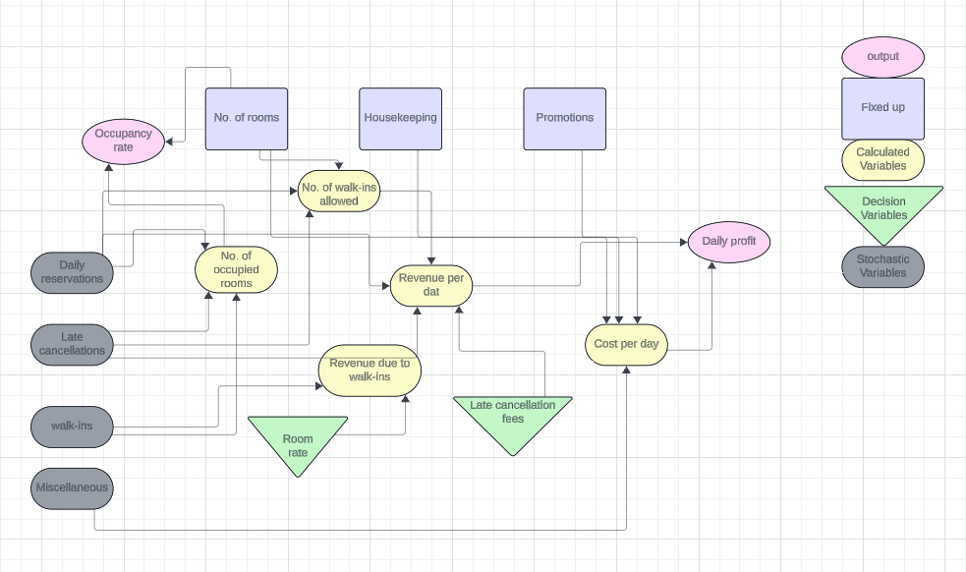
CONCEPTUAL DIAGRAM

Slide 6
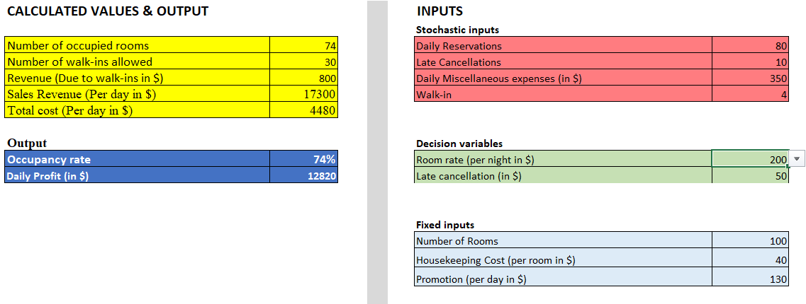
Spreadsheet based Decision models

Slide 7

Daily Bookings: It is assumed that there are 80 reservations each day (base estimate).
Cancellations: At least 10 late cancellations can occur daily in real time.
Miscellaneous Expenses: Daily miscellaneous expenses are estimated at around 350
Walk-ins: Approximately 4 walk-in guests are expected each day. Room Rate Choices: The manager can set the room rate at either $200 or $250.
Cancellation Charges: the late cancellation fee is 50 per room.
Room Capacity: Hotel Paradise Resort has a maximum capacity of 100 rooms.
Housekeeping Costs: Maintenance costs are 40 per room per day
Promotion Costs: Promotional costs are 130 per room per day
These values are constant to keep the model simpler
ASSUMPTIONS

Slide 8
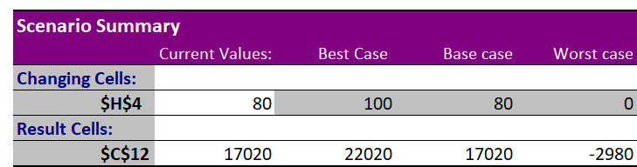
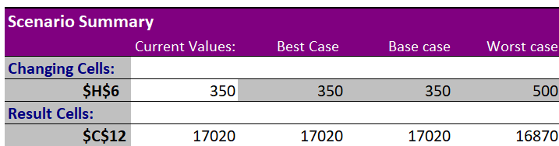
Scenario Analysis
Daily reservations for $250
At 100 reservations, the $250 room rate yields significantly higher profits ($22,020) compared to $16,820 at the $200 rate. This trend continues at 80 reservations, with $17,020 versus $12,820. Losses at no reservations are slightly higher for the $250 rate ($2,980) than for the $200 rate ($3,180). Thus, setting the room rate at $250 maximizes profitability with minimal additional risk, especially during peak demand.
Maintaining daily expenses at $350 maximizes profits at $16,820 for the $200 rate and $17,020 for the $250 rate. Increasing expenses to $500 decreases profits. The $250 rate yields slightly higher profits under the same conditions, making it the recommended option. Thus, setting daily miscellaneous expenses at $250 optimizes profitability for Hotel Paradise, ensuring the best financial outcome.
Daily Miscellaneous expenses at $250

Slide 9
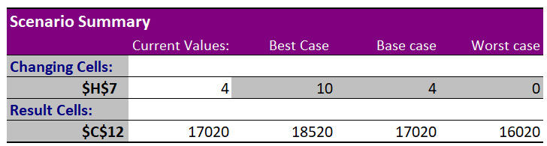
Scenario Analysis
Walk-ins for $250
At the $200 rate, increasing walk-ins from 4 to 10 raises profits by $1,200 from $16,820 to $18,020. For the $250 rate, this increase boosts profits by $1,500 from $17,020 to $18,520. The $250 rate consistently yields higher profits at equivalent walk-in levels, with an incremental profit gain larger than at the $200 rate. Thus, setting walk-ins at $250 not only maximizes returns per guest but also enhances overall profitability more effectively than the lower rate.

Slide 10
Stochastic variables choice of distribution
In the stochastic modelling for Hotel Paradise, distinct probability distributions have been selected for various operational inputs, based on their inherent characteristics and behaviours in the hotel's business context:
Daily Reservations (60): The Poisson distribution is suitable for modeling the number of daily room reservations, which typically occur randomly but average around a certain number. The value of 60 is based on historical data and current market trends, providing a realistic estimate.
Late Cancellations (12): The average number of daily cancellations is modeled using the Poisson distribution to account for the variability and frequency of these events. Cancellations occur randomly but tend to average around 12 per day.
Daily Miscellaneous Expenses ($348): Miscellaneous expenses fluctuate daily but usually average around a specific amount. Using the Poisson distribution helps capture the natural variability of these expenses around the mean value of $348.
Walk-ins (3): Walk-in guests are less frequent and irregular, making the Poisson distribution ideal for modelling their occurrence. The average of 3 walk-ins per day reflects the typical pattern observed in this context.
These Poisson distribution values accurately reflect the real-world scenarios of random, independent events occurring around an average, enabling better management of resources and revenue.

Slide 11
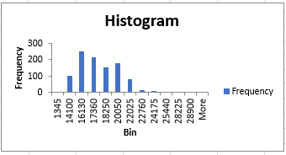
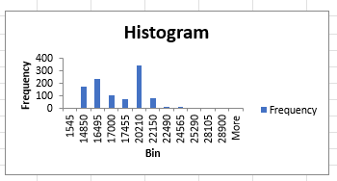
Descriptive statistics of simulated outputs
Mean Profit: Similar average profits ($21,514.6 for $200, $21,401.2 for $250).
Standard Deviation: Less variability at $250 rate ($2,201.6 vs. $2,301.4).
Profit Range: Higher maximum profit for $250 ($28,400 vs. $28,000).
Probability of Loss: 0% for both rates.
Confidence Limits: $250 rate shows narrower confidence interval.
IQR: Narrower for $250 rate ($2,991.90 vs. $3,254.41).
Percentiles: $250 rate has a lower risk of very low profits.
The histogram for the $200 rate shows profits are mostly between $16,130 and $20,050, indicating moderate consistency.
In contrast, the $250 rate histogram reveals a wider distribution, with profits peaking around $20,210.
This suggests higher potential profits but also greater variability. The $250 rate has more instances of higher profits, but with increased fluctuation.

Slide 12
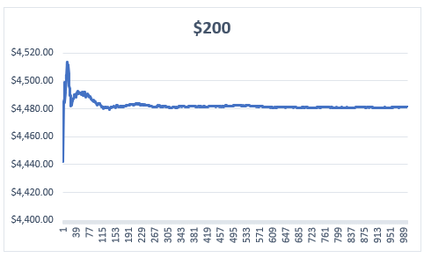
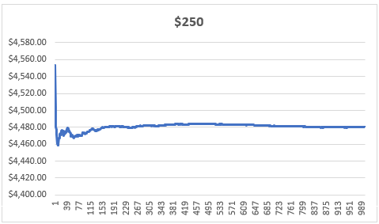
AVERAGE DAILY PROFITS
$200 Room Rate: Peaks early at around $4,520 before stabilizing near $4,460. This indicates a brief high-profit period followed by a more consistent, lower profit level.
$250 Room Rate: Shows initial fluctuations, peaking near $4,540, then stabilizes at approximately $4,480, maintaining a higher level of consistent profits compared to the $200 rate.
Both graphs demonstrate an early peak in profits, but the $250 rate maintains higher consistent profits post-fluctuation, suggesting it provides more stable and predictable revenue.

Slide 13
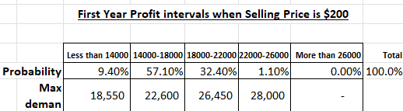
Risk analysis for $200
Stable Profits (57.10%): Regularly achieve $14,000 to $18,000; maintain focus on this reliable profit range.
Opportunity for Growth (32.40%): Utilize promotions and upselling during high demand to reach $18,000 to $22,000.
Rare High Gains (1.10%): Profits above $22,000 are possible but infrequent.
Minimal Risk (9.40%): Prepare for the possibility of profits below $14,000 with robust cost management and contingency strategies.
Implications:
Prioritize stabilizing core profits while strategically targeting higher revenue opportunities and safeguarding against potential downturns.

Slide 14
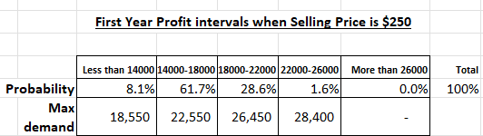
Risk analysis for $250
Stable Core Revenue: The most frequent scenario, with a 61.7% probability, sees daily profits between $14,000 and $18,000, ensuring a reliable financial base.
Growth Potential: There’s a 28.6% chance of achieving $18,000 to $22,000, offering significant opportunities for revenue enhancement during peak periods.
Low Risk of Low Returns: Only an 8.1% risk of profits dropping below $14,000, indicating strong financial stability.
Uncommon High Profits: High profits above $22,000 are rare, occurring just 1.6% of the time, and shouldn’t be expected regularly

Slide 15
Conclusion for risk analysis
Revenue Consistency and Risk Management
The $250 rate provides more consistent revenue with a 61.7% chance of moderate profits ($14,000 to $18,000) versus 57.1% for the $200 rate. It also has a lower risk of profits dropping below $14,000 (8.1% vs. 9.4%).
Market Trends
The $250 rate captures higher demand for mid-tier profits more effectively, indicating stronger anticipated performance.
Pricing Approach
The $250 rate strikes a balance between profitability and risk, making it a more attractive option for maximizing revenue.
Revenue and Occupancy Stability
The $250 rate guarantees higher and more consistent profits, supporting effective financial planning and stable occupancy.

Slide 16
Recommendations
Optimize Pricing Strategy: Use a dynamic pricing model, setting room rates at $250 during peak demand and $200 during off-peak times. This balances higher profitability with flexibility to attract guests year-round.
Enhance Guest Satisfaction: Improve guest services and amenities to boost repeat bookings and positive reviews. Personalized experiences and high-quality services foster customer loyalty and referrals.
Analyse and Adapt Booking Trends: Regularly review booking data to fine-tune marketing and pricing strategies. Focus on maximizing occupancy by targeting the higher probability of reservations at the $250 rate for stable revenue.
Implement Flexible Reservation Policies: Offer flexible booking and cancellation options to attract last-minute reservations and minimize no-shows, improving overall occupancy rates.
Manage Risks Effectively: Continue to manage overbooking carefully to avoid potential negative impacts on guest satisfaction. Effective compensation strategies for overbooked guests can maintain a positive reputation and customer trust.

